Slide 1

TYPE 2 DIABETES • POLYGENIC RISK SCORES • HEALTH EQUITY
A Secondary Analysis: Cross-Ancestry Transferability of European Type 2 Diabetes Risk Scores to South Asian Populations
Kim Luong, B.S.
McWilliams School of Biomedical Informatics, UTHealth Houston
BMI 6313: Scientific Writing in Healthcare | Dr. Lex Frieden
Notes:
Hello, I'm Kim Luong. Today I'll present my study on why a diabetes risk score built from European genetic data performs poorly in South Asian populations, and what's actually driving that failure.

Slide 2

A Genetic Weather Forecast for Disease
STEP 1
STEP 2
STEP 3
Scan the genome
Add up the signals
Forecast the risk
Studies compare the DNA of thousands of people to find spots linked to a disease.
A polygenic risk score sums thousands of small genetic effects into one number.
The goal: flag high-risk people years before disease develops, so they can act early.
3
Notes:
A polygenic risk score works like a weather forecast for your health. Scientists scan the genomes of thousands of people to find small genetic differences linked to a disease, then add up thousands of these signals into one number that estimates personal risk — ideally, years before diabetes develops.

Slide 3

A Disease Growing Fastest Where We’ve Studied It Least
Polygenic risk scores (PRS) could flag high-risk individuals years before diabetes onset, but the discovery data behind them is deeply skewed.
783M
Central & South Asian populations are among the least represented in this data — despite carrying the highest disease burden. (Ding et al., 2023)
people projected to have type 2 diabetes globally by 2045 (Hossain et al., 2024)
91%
Central and South Asian populations carry some of the highest rates of type 2 diabetes in the world — yet remain among the least represented in the genetic studies meant to help predict it. (Fitipaldi & Franks, 2022; Ding et al., 2023)
CSA Underrepresented: Most vulnerable to T2D, least studied in genomic research
2
Notes:
Type 2 diabetes is projected to affect 783 million people by 2045, and Central and South Asian populations carry some of the highest rates in the world. Yet 91 percent of participants in the genetic studies behind these risk scores are of European ancestry. The population that needs this tool most is among the least represented in the data used to build it.

Slide 4



Drivers of Cross-Ancestry Failure
Allele frequency differences
LD structure mismatch
How common a disease-linked variant is can differ across ancestries, so a score calibrated on European data can misjudge genetic risk elsewhere. (Mahajan et al., 2022)
Nearby variants are inherited together in clusters (haplotypes), and these patterns differ by population — so European index variants can miss the true causal variants elsewhere.
70–80% of cross-ancestry PRS accuracy loss is attributed to these two factors in prior research (Kachuri et al., 2024; Wang et al., 2020)
6
Notes:
Two known mechanisms explain why European-built risk scores often fail elsewhere. Disease-linked variants can differ in frequency across populations, and the patterns of linkage, nearby variants inherited together, called linkage disequilibrium, also differ by ancestry. Together, prior research attributes 70-80% of cross-ancestry accuracy loss to these two factors.

Slide 5

But for South Asians, What’s Really Driving It?
1
2
3
Different Biology
Technical Artifacts
Limited Discovery Power
Disease architecture genuinely diverges across ancestries
Mismatched linkage-disequilibrium (LD) patterns and allele frequencies
Simply not enough South Asian GWAS data to estimate effects precisely
Hypothesis: Limited discovery power in South Asian cohorts — not divergent disease biology — is the dominant driver of poor PRS transferability. The distinction matters: the fix differs completely depending on which is true.
Our hypothesis: the data gap, not the biology, is the main culprit.
6
Notes:
So why do these scores fail in South Asian populations specifically? Three possibilities: the disease biology genuinely differs, there's a technical flaw in how the score is built, or there simply isn't enough South Asian data yet. Our hypothesis: limited discovery data, not different biology, is the dominant driver — and the fix depends entirely on which is true.

Slide 6
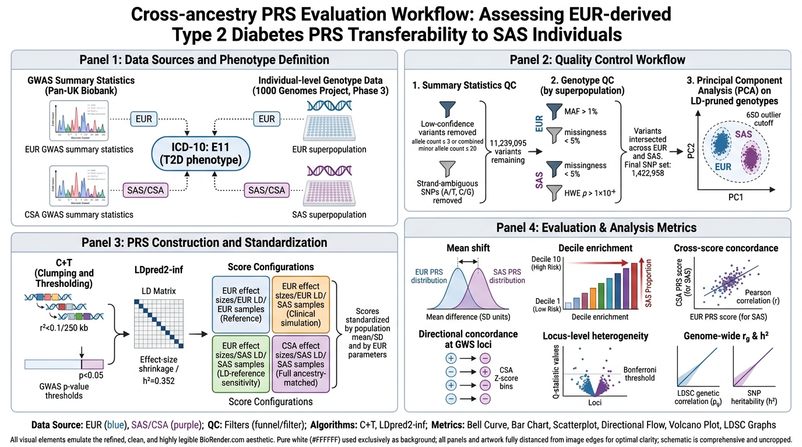
Study Design at a Glance
Public summary statistics + individual genotypes → QC & ancestry PCA → four PRS configurations → five transferability metrics
4
Notes:
Here's the overall design: public genetic data, quality control, four score configurations, and five ways of testing whether the score transfers across populations.

Slide 7
1. Data Sources and Phenotype Definition
Public summary statistics + individual genotypes → QC & ancestry PCA → four PRS configurations → five transferability metrics
4
Notes:
I used publicly available genetic summary data for European and South Asian groups, both defined by the same type 2 diabetes diagnosis code. Individual genotypes came from the 1000 Genomes Project, used as ancestry-matched reference samples.

Slide 8
2. Quality Control Workflow
Public summary statistics + individual genotypes → QC & ancestry PCA → four PRS configurations → five transferability metrics
4
Notes:
Before scoring, both datasets went through quality control. I removed low-confidence variants from the summary data, leaving about 11.2 million, and filtered the genotypes separately by population, leaving 1.42 million shared variants. A principal component analysis confirmed ancestry and flagged outliers, leaving 503 European and 478 South Asian individuals for scoring.

Slide 9
3. PRS Construction and Standardization
Public summary statistics + individual genotypes → QC & ancestry PCA → four PRS configurations → five transferability metrics
4
Notes:
I built scores two ways. Clumping and thresholding sums a set of near-independent variants. LDpred2-inf instead models all variants genome-wide at once, using each population's own linkage patterns and a heritability estimate. Critically, I built four configurations that mix effect sizes and linkage references across ancestries, so I could isolate what actually drives any miscalibration.

Slide 10
4. Evaluation and Analysis Metrics
5
Notes:
I evaluated transferability five ways: how far the score distribution shifts between populations; how over- or under-represented high-risk individuals are in each risk decile; how well European- and South-Asian-derived scores agree at the individual level; whether individual gene regions show different effects between populations; and whether the overall genetic architecture is shared or diverges genome-wide.

Slide 11
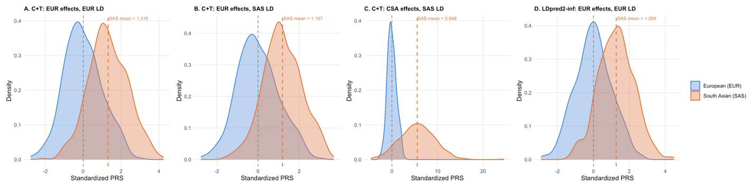
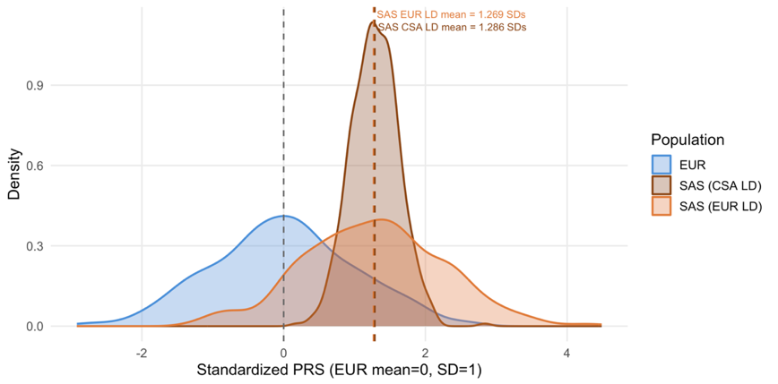
The Limiting Factor Is Discovery Power, Not the Scoring Method
Figure 2. Density distributions of standardized PRS across score configurations.
+1.3 SD
upward shift in South Asian scores under both methods (C+T: 1.32 SD, LDpred2-inf: 1.27 SD)
1.32 → 1.19 SD
Swap LD reference only modestly narrowed the shift .
1.19 → 5.55 SD
Swap effect-size source made the shift larger and far noisier
0.34 vs 0.98 SD
Shift stays ~1.29 SD, but the distribution collapses instead of widening.
Figure 3. LDpred2-inf PRS density across ancestry groups.
6
Notes:
Under both methods, European-derived scores shifted the South Asian distribution up by about 1.3 standard deviations. Swapping in a South-Asian-matched linkage reference only modestly narrowed that, from 1.32 to 1.19 — so the reference panel isn't the main driver. Using South-Asian-derived effect sizes instead sent the shift to 5.55, with a much noisier spread, because those estimates come from a study of only about 1,600 cases. LDpred2-inf shows the same cause differently — its distribution collapses instead of widening, since it shrinks effects using a noisier heritability estimate. Different symptoms, same root cause: too little data.

Slide 12
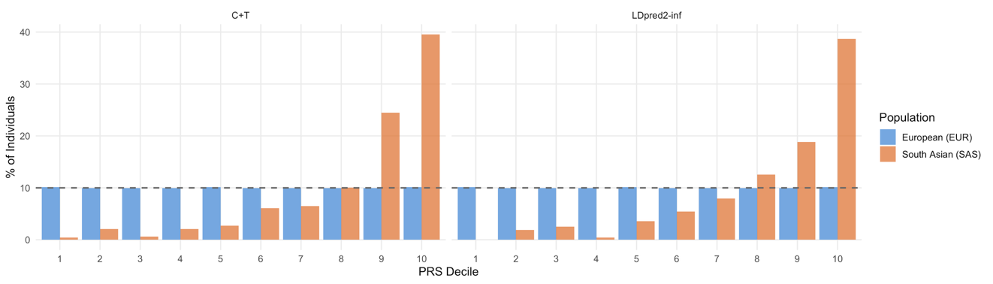
Clinical Risk Stratification Is Miscalibrated
Figure 4. PRS decile distribution: percentage of individuals in each of ten risk deciles
Near-Zero Concordance
~4× Enrichment
between European- and South-Asian-derived individual scores (r = −0.001 to 0.047)
of South Asians in the highest-risk decile vs. the 10% expected
High-risk individuals by EUR score ≠ High-risk individuals by CSA score
7
Notes:
The clinical consequence: South Asian individuals were nearly absent from the lowest risk deciles, and about four-fold overrepresented in the highest. A clinician using this score unadjusted would flag far too many South Asian patients as high-risk, and almost none as low-risk.

Slide 13
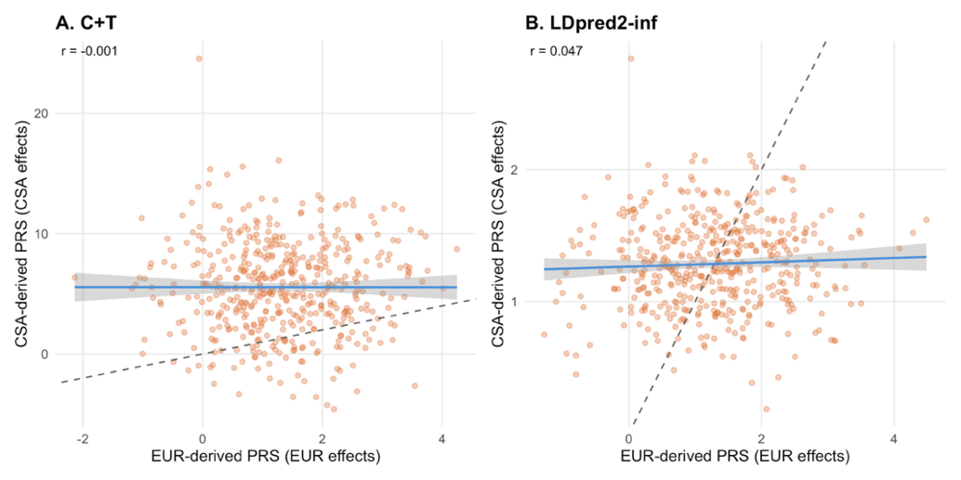
The Paradox: Shared Biology, Divergent Scores
If the scores disagree so completely — is the underlying disease biology just different?
Individual-Level Scores
Genome-Wide Architecture
r ≈ 0
near-zero correlation between EUR- and CSA-derived scores
rg = 1.27
p = 6.7×10⁻¹¹ — indistinguishable from perfect sharing; similar SNP-heritability in both groups (0.036 vs 0.028)
Looks like a fundamental mismatch...
...but the shared biology says otherwise.
Figure 5. Cross-Ancestry Score Concordance
9
Notes:
If the scores disagree this completely, is the underlying biology different? I tested that directly with genome-wide genetic correlation, and it was high — 1.27, essentially indistinguishable from complete sharing — with similar heritability in both groups. The scores disagree individually, but the biology they're both trying to capture is the same.

Slide 14
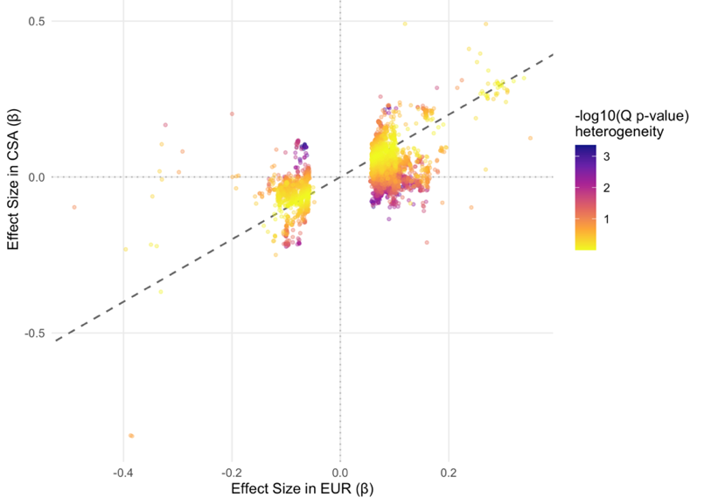
Statistical Power Reconciles the Paradox
Table 1. Directional Concordance by CSA Signal Strength
CSA |Z|
% Same Direction as EUR
< 1 (weak)
63.7%
1 – 2
71.3%
2 – 3
98.0%
> 3 (strong)
100%
0 of 8,789
genome-wide-significant loci — including TCF7L2, the strongest known T2D gene — showed significant EUR–CSA heterogeneity after correction.
Figure 6. EUR vs. CSA effect sizes at 8,789 EUR genome-wide-significant T2D loci, colored by heterogeneity.
The biology looks shared, not divergent.
10
Notes:
What reconciles shared biology with such poor agreement? Statistical power. Agreement between European and South Asian effect estimates rose from 64 percent at weakly-powered loci to 100 percent at well-powered ones. Across nearly 8,800 loci — including the strongest known diabetes gene — none showed a real difference. This isn't biology; it's what happens when you estimate small effects from a small sample.

Slide 15
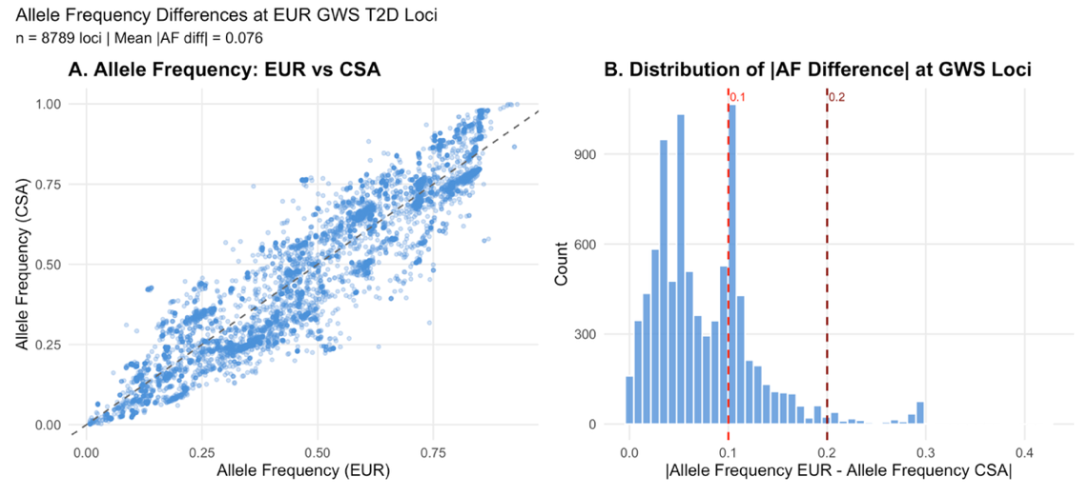
Allele Frequency and LD Differences Explain Part of the Gap
Figure 7. (A) Risk allele frequency, EUR vs. CSA, at 8,789 EUR GWAS T2D loci. (B) Distribution of absolute allele-frequency differences.
Most loci show similar allele frequencies across populations (mean difference = 0.076), but a subset diverge substantially (0.25–0.3). Swapping in a South-Asian-matched LD reference alone reduced the C+T mean shift from 1.32 to 1.19 SD — these mechanisms contribute, but don’t fully explain, the miscalibration.
13
Notes:
Allele frequency and linkage differences do contribute, but only partly. Most risk variants had similar frequencies across populations, though some diverged substantially. And swapping in a South-Asian-matched linkage reference narrowed the shift from 1.32 to 1.19 standard deviations — real, but nowhere near enough to close the gap.

Slide 16

It's Not the Biology — It's the Data
1
Miscalibration is real and consequential
Whole-distribution shifts and 4× over-flagging of high risk in South Asian individuals
2
But the disease biology is largely shared
High genetic correlation (rg=1.27) and zero loci with true EUR–CSA heterogeneity (cf. Bulik-Sullivan et al., 2015)
3
Better algorithms alone didn't fix it
LDpred2-inf's more sophisticated LD modeling gave no transferability advantage over C+T (cf. Choi et al., 2020; Privé et al., 2021)
4
The path forward is more data, not more math
Expanding South Asian-specific GWAS is the most direct route to equitable T2D risk prediction (Martin et al., 2019)
11
Notes:
So, here's where this lands. The miscalibration is real and consequential — the whole distribution shifted, and nearly four times too many South Asians were flagged high-risk. That's not because the biology differs: genetic correlation was 1.27, essentially fully shared, with zero real differences across nearly 8,800 loci. It's also not simply the algorithm — LDpred2-inf models linkage far more carefully than clumping and thresholding, yet transferred no better. What's left is the data. Expanding South Asian-specific genetic studies, not building a smarter model, is the most direct path to equitable diabetes risk prediction.

Slide 17
Limitations & What Comes Next
Limitations
Future Directions
Genotype-level, not clinical validation: The 1000 Genomes panel has no phenotype data, so transferability was assessed through genotype-level metrics — score shift, decile enrichment, concordance, heterogeneity, genetic correlation — rather than actual predictive accuracy in diagnosed patients.
Small CSA GWAS sample size (1,662 cases): This is the central limitation of the study — but also arguably its central finding. The underrepresentation itself is the story, not just a caveat on it.
"South Asian" is not one population: The CSA and SAS labels collapse substantial genetic diversity within South Asia (e.g., differences among Pakistani, Bangladeshi, Indian, and Sri Lankan ancestries) that the 1000 Genomes SAS superpopulation doesn't fully capture.
Expand CSA-specific GWAS: Existing efforts — DIAMANTE, SAT2D, the South Asia Biobank — could substantially increase CSA case numbers well beyond the 1,662 used here. (cf. Mahajan et al., 2022)
Pair genetics with larger phenotyped cohorts: This would allow direct testing of clinical predictive accuracy, not just genotype-level transferability.
Prioritize representation over new methods: Because miscalibration reflects limited ancestry representation rather than distinct biology, expanding CSA inclusion in genomic studies is the most effective path to equitable T2D PRS — more so than further algorithmic refinement.
12
Notes:
A few limitations: the 1000 Genomes panel has no clinical outcome data, so I measured transferability at the genotype level, not real predictive accuracy — and 'South Asian' here collapses real population diversity. Going forward, efforts like the South Asian Type 2 Diabetes Consortium or the South Asia Biobank could expand South Asian case numbers well beyond what I had, paired with larger clinical cohorts to test real-world performance.

Slide 18
References
Bulik-Sullivan, B., Finucane, H. K., Anttila, V., et al. (2015). An atlas of genetic correlations across human diseases and traits. Nature Genetics, 47(11), 1236–1241.
Choi, S. W., Mak, T. S. H., & O’Reilly, P. F. (2020). A guide to performing Polygenic Risk Score analyses. Nature Protocols, 15(9), 2759–2772.
Ding, Y., Hou, K., Xu, Z., et al. (2023). Polygenic scoring accuracy varies across the genetic ancestry continuum. Nature, 618(7966), 774–781.
Fitipaldi, H., & Franks, P. W. (2022). Ethnic, gender and other sociodemographic biases in GWAS for the most burdensome non-communicable diseases: 2005–2022. Human Molecular Genetics, 32(3), 520–532.
Hossain, M. J., Al-Mamun, M., & Islam, M. R. (2024). Diabetes mellitus, the fastest growing global public health concern. Health Science Reports, 7(3), e2004.
Kachuri, L., Chatterjee, N., Hirbo, J., et al. (2024). Principles and methods for transferring polygenic risk scores across global populations. Nature Reviews Genetics, 25(1), 8–25.
Mahajan, A., Spracklen, C. N., Zhang, W., et al. (2022). Multi-ancestry genetic study of type 2 diabetes highlights the power of diverse populations for discovery and translation. Nature Genetics, 54(5), 560–572.
Martin, A. R., Kanai, M., Kamatani, Y., et al. (2019). Current clinical use of polygenic scores will risk exacerbating health disparities. Nature Genetics, 51(4), 584–591.
Privé, F., Arbel, J., & Vilhjálmsson, B. J. (2021). LDpred2: Better, faster, stronger. Bioinformatics, 36(22–23), 5424–5431.
Wang, Y., Guo, J., Ni, G., et al. (2020). Theoretical and empirical quantification of the accuracy of polygenic scores in ancestry divergent populations. Nature Communications, 11, 3865.
13
Notes:
Thank you.

